Slide 1
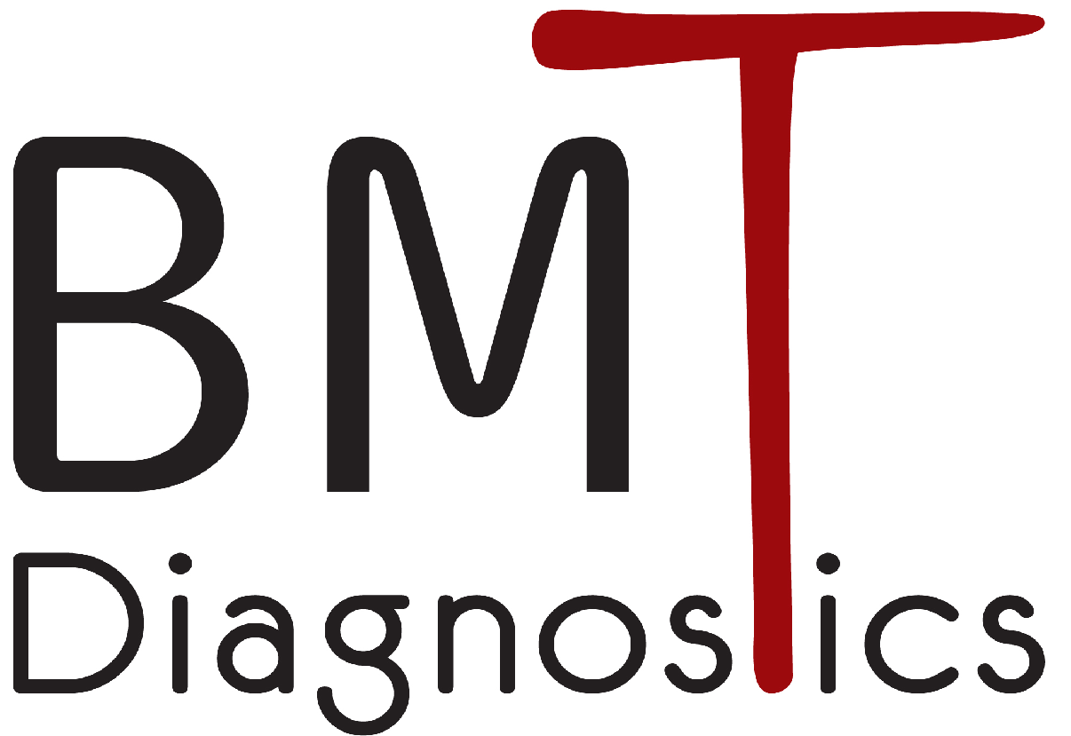

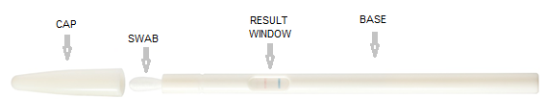
Intelligent, Convenient
Rapid Diagnostic Testing
Introducing:
TM

Slide 2
Who we are
BMT Diagnostics was Founded in 2004
Automatic manufacturing lines with high QC capabilities
ISO 13845:2016 – certified
ISO5 aseptic manufacturing space
Multiple CE-marked products
Our Vision
Providing smart, innovative and convenient RDT solutions for Point Of Care (POC) and self testing

Slide 3
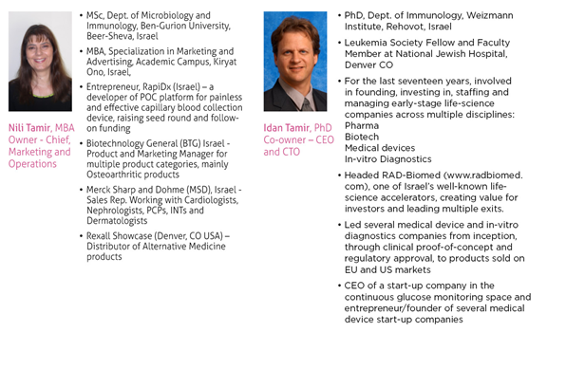
Experienced Management Team

Slide 4
The Unmet Need
Available Rapid Diagnostic Tests (RDT) for most infectious diseases are:
Difficult to perform
Time and attention consuming
Non-intuitive
Usually preformed in a laboratory
Operator-dependent accuracy
Our Solution - ™
The First Patented Platform that allows No Step Convenient and Accurate RDT Performance

Slide 5
TM
Main Advantages:
This platform improves the process of patient screening shifting patient screening from centralized labs to point-of-care, improving HMO service, saving time & money.
Proprietary swab for improved sample collection and higher pathogen recovery efficacies
No Step operation
Improved usability by untrained healthcare providers
Results available during in-patient visit
Enhanced accuracy
Minimal liquid and plastic waste disposal
Swab-based Test Platform

Slide 6
TM
Proprietary, Innovative Platform for Multiple Swab-Based Rapid Diagnostic Indications:
Streptococcus A
COVID-19 Antigen
Influenza A+B
Streptococcus B
RSV
Multiple additional indications
R&D process on combo tests
Patents granted world wide, with several Continuation Applications
Swab-based Test Platform

Slide 7
Strong and Diversified Israeli Customer Base:
All HMOs
Hospitals
Military
Police
Pharmacies – private and the two leading chains (total >500 individual sites)
Super Pharm (Over 300 sites)
Be (New Pharm -Over 80 sites)
Private clinics
Medical centers
Marketing Activity - Israel

Slide 8
Growing International Customer Base:
Europe (ongoing)
Australia (TGA approval received)
USA (FDA approval expected in 2025-Q2)
Marketing Activity - International

Slide 10

Thank You!

